Slide 1
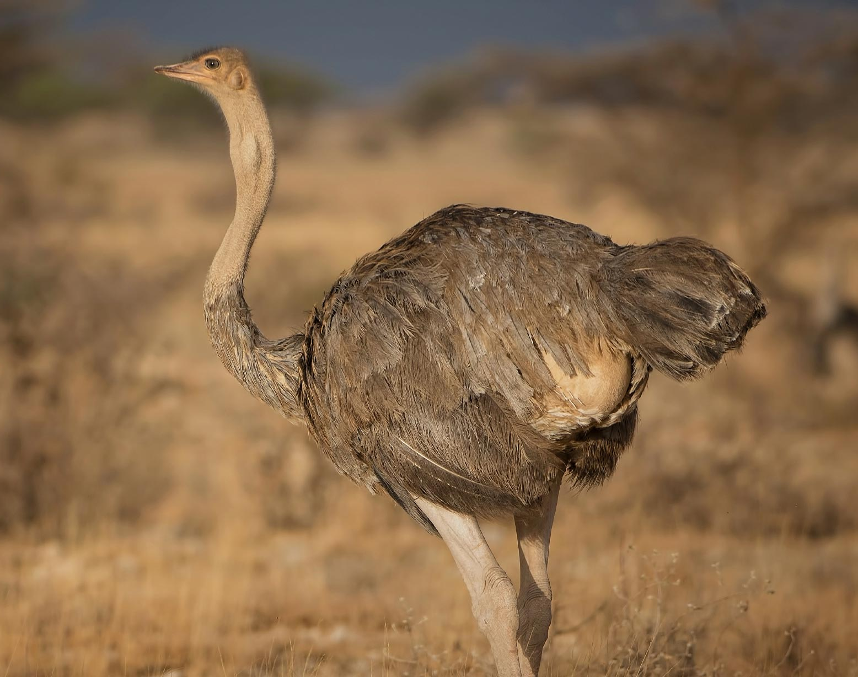
OSTRICH: A Flightless Bird
Ranjana Karmakar

Slide 2
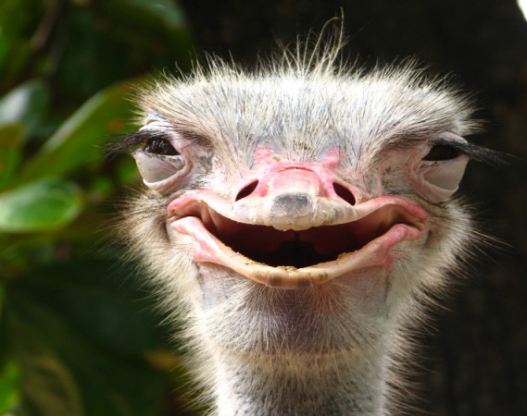
Introduction
The ostrich is a bird everyone recognizes easily; not because it is brightly colored, like the peacock or parrot, nor because it looks intelligent, like the owl, but rather for its sheer size and ungainly appearance. The ostrich is a unique bird; its large size excludes it from flying and it is strictly terra firma-bound. Ostriches are large flightless birds.

Slide 3
Systematic position
OSTRICH: Struthio camelus
The common ostrich, or simply ostrich, is a species of flightless bird native to certain large areas of Africa. It is one of two extant species of ostriches, the only living members of the genus Struthio in the ratite order of birds.
According to J.Z.Young,1981
Kingdom: Animalia
Phylum: Chordata
Subphylum: Vertebrata
Class: Aves
Subclass: Ratitae
Order: Struthioniformes
Family: Struthionidae
Genus: Struthio
Species: Struthio camelus

Slide 4
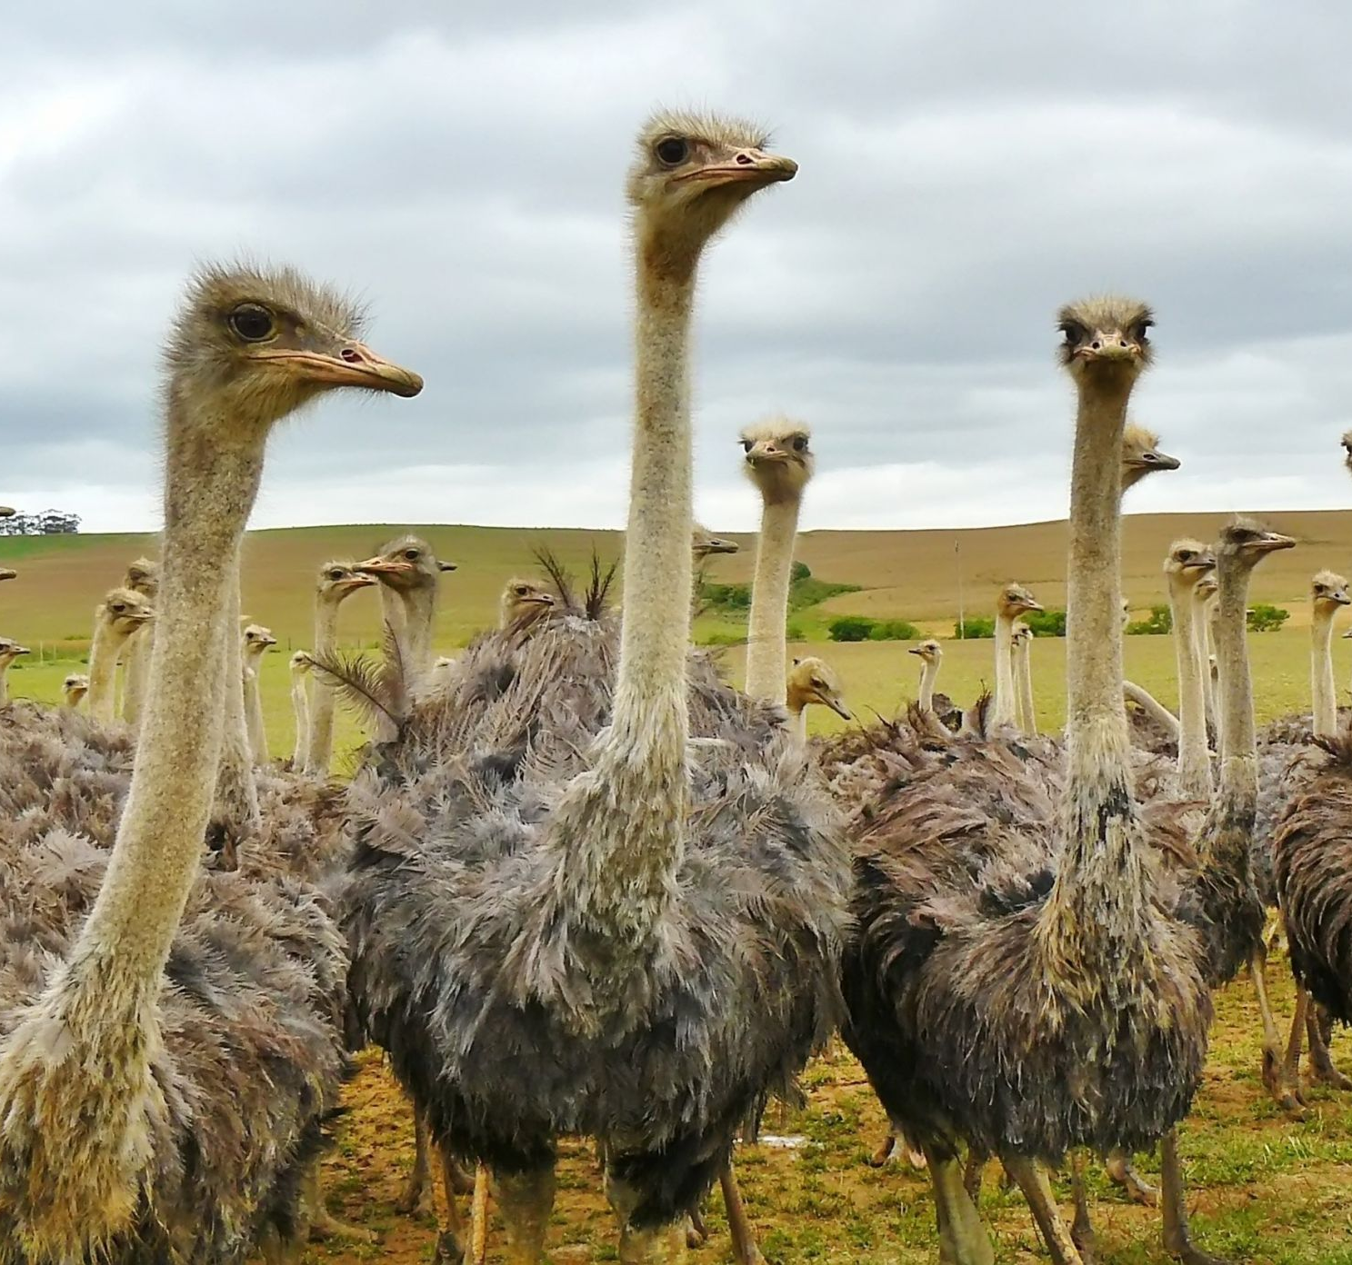
General behavior
Ostriches are highly social birds, and their tendency to live in groups serves various purposes, particularly in defense against predators. These groups, known as flocks, generally consist of around 10 individuals or may comprise a male and female pair. However, larger gatherings of 100 or more ostriches are not uncommon. Within these groups, a pecking order exists, with a dominant male leading the hierarchy. The dominant female, often referred to as the "main hen," holds a prominent position, and there are several other females in the group. When being pursued by a predator, they have been known to reach speed in excess of 70 km/h or possibly 80 km/h and can maintain a steady speed of 50 km/h, which makes the common ostrich the world's fastest running bird. This social structure helps facilitate cooperation, protection, and successful breeding within the ostrich community.

Slide 5
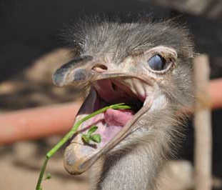
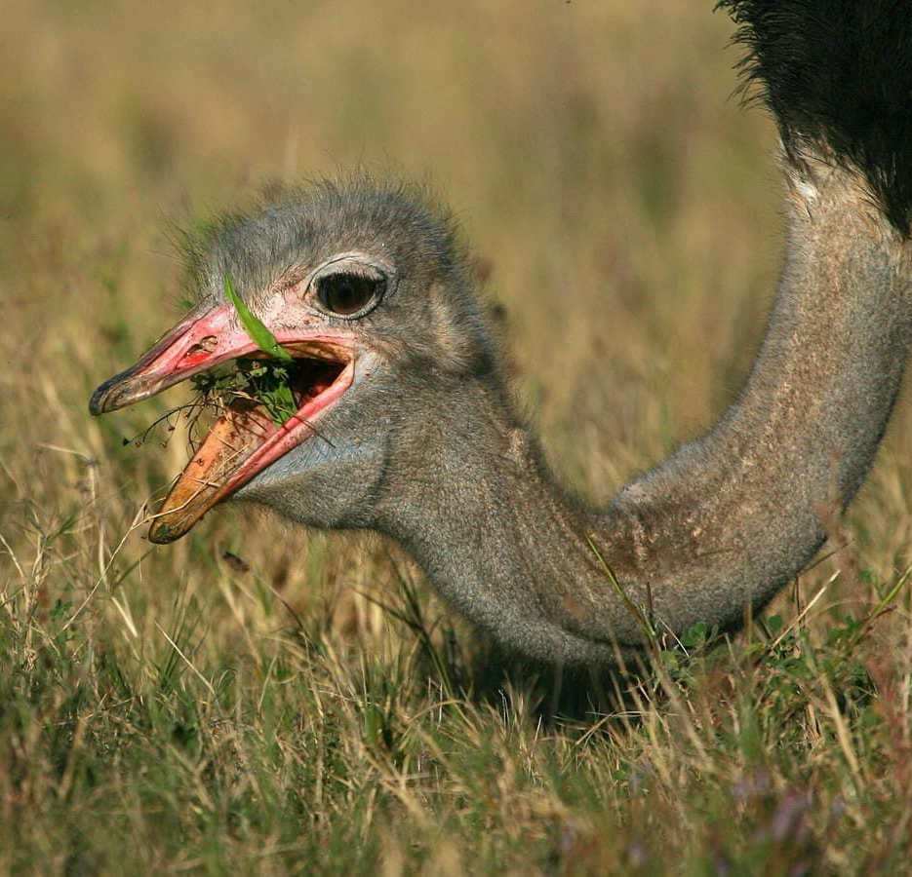
Feeding behavior
Ostriches are herbivores, primarily grazing on plants, seeds, and vegetation. They use their beaks to peck at low-lying vegetation and are known to consume a variety of plant materials, including grasses, leaves, flowers, and fruits. Occasionally, they may eat small invertebrates like insects and worms. Ostriches lack teeth, so they swallow stones (grit) to aid in the grinding and digestion of their food in the gizzard. In the wild, they forage in open grasslands, utilizing their powerful legs and long necks to reach their food. Ostriches can survive in arid environments, obtaining water from the plants they consume and drinking larger quantities when available. Common ostriches can go without drinking for several days, using metabolic water and moisture. In captivity, they may be provided with a balanced diet, including grains and supplements. Social animals, ostriches often forage together, enhancing vigilance against predators. Understanding their feeding behavior is essential for their proper care and nutrition in both wild and captive settings.

Slide 6
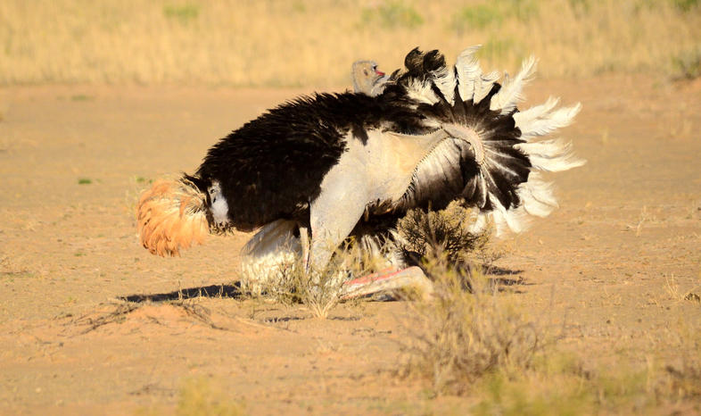
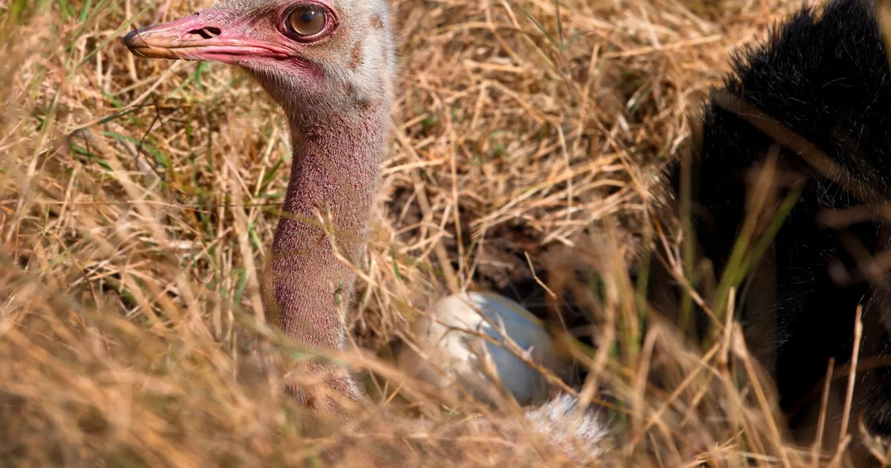
Breeding habits
Ostriches are polygamous birds, with dominant males establishing territories and mating with multiple females. Breeding season varies geographically but often occurs during the rainy season. During courtship displays, males perform elaborate dances, spreading their wings and bobbing their heads. The dominant male attracts females through these displays. Once a female is chosen, she lays eggs in a communal nest, and multiple females may contribute to the same nest. The dominant male guards the nest during the day, and the dominant female takes over at night. Ostrich eggs are the largest of any bird species and are incubated by the dominant female during the day and by the dominant male at night. The incubation period is around 42 to 46 days, and both parents actively participate in raising the chicks, which can fend for themselves shortly after hatching.
Mating time

Slide 7
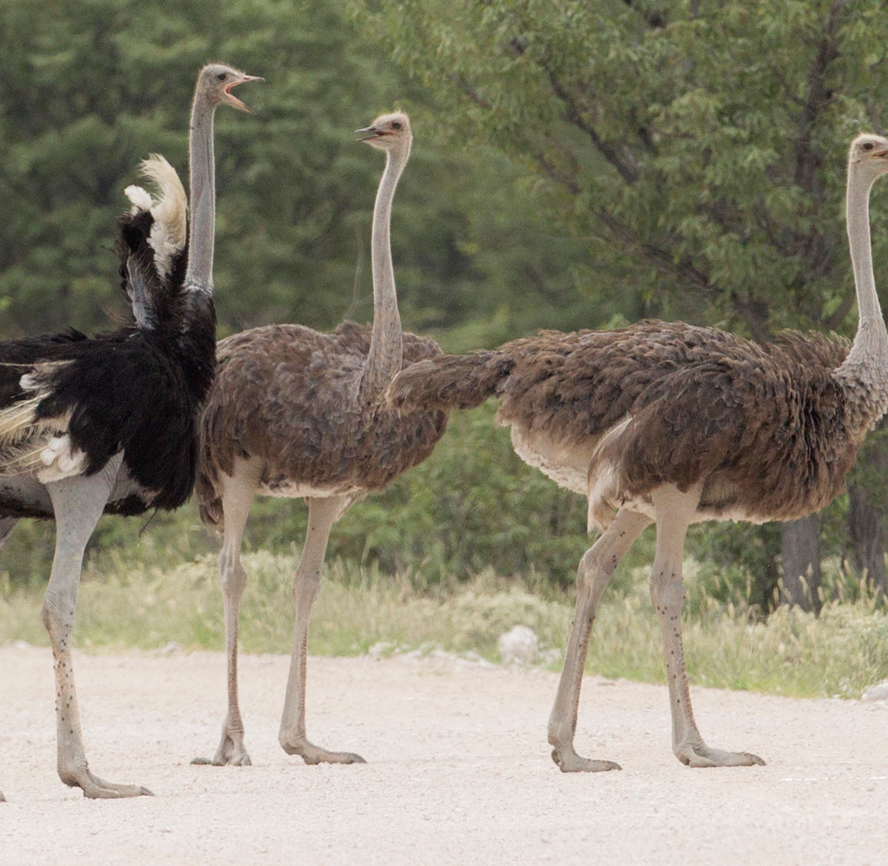
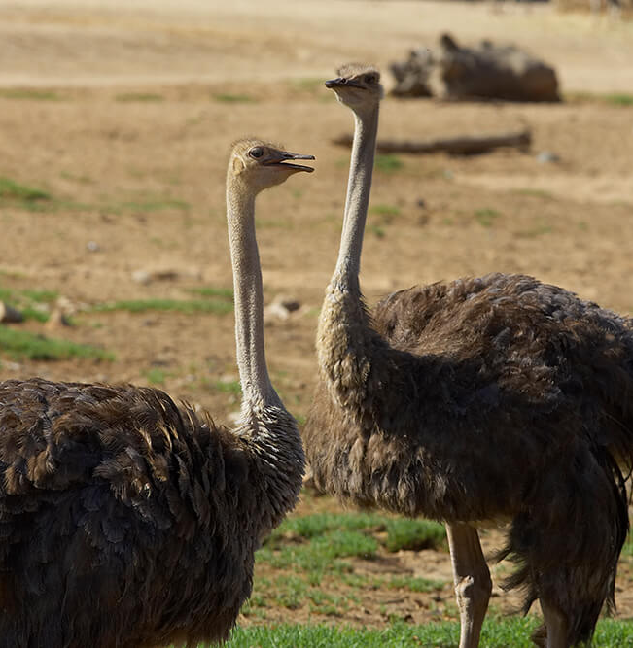
Conclusion
To sum up, the ostrich, with its unique features and behaviors, stands out as the world's largest bird. From its herbivorous diet to its social nature in groups, the ostrich's adaptability and cooperative strategies, such as the pecking order within flocks, showcase its intriguing biology. Appreciating these aspects enhances our understanding of ostriches and underscores the importance of their conservation.

Slide 8
Acknowledgement
In the accomplishment of completion of my project on the ostrich, I would like to convey my special gratitude to the respected professors of Department of Zoology, Bangabasi Morning College. Their valuable guidance and suggestions helped me in various phases of the completion of this project. I will always be thankful to them in this regard.

Slide 9
Thank You

